Slide 1


Ezechias Mirindi
April, 2025

Slide 2

Outline
Executive Summary
Introduction
Methodology
Results
Conclusion
Appendix

Slide 3
Executive Summary
Aerospatiale companies struggle with building sophisticated spacecrafts as they bear huge costs. To minimize the construction costs, SpaceX wants to reuse the first stage of Falcon 9 for its next space mission. This project aims at predicting whether that first stage will be launch and land successfully based on the past launch data of Falcon 9 rockets.
For this project, data was collected using SpaceX API and Webscraping. After data collection, Data went through the wrangling process for cleaning it. To understand the data, we performed Exploratory Data analysis by writing SQL requests, visualizing data and analyzing data on map using Folium library. To make predictions we used four Machine learning algorithms – Logistic Regression, Support Vector Machine, Decision Tree and K Nearest Neighbors.
The results showed that launches were successful as time passed and with bigger payloads. Most of the launch sites were near coastlines to reduce the risk of impacting population and infrastructures during launching operations. Finally, after training the algorithms, The Decision Tree resulted to be the best algorithm for SpaceX data with a prediction accuracy of 94% on the test data.

Slide 4
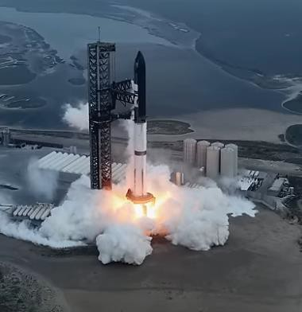
Introduction
Nowadays, space exploration has become a true passion for some big firms like Galactic, Rocket-Lab, Blue Origin, etc. Some of these firms build and send spacecrafts to space stations and one of the most successful companies is SpaceX. As competition grows among companies, the latter wants to explore space by optimizing their costs.
This project aims at providing cost information to companies who want to bid against SpaceX. SpaceX will use the first stage of falcon 9 for its next mission. If we can predict whether the first stage will land successfully then we can determine the cost of the launch. And this information can be important to competitors.

Slide 5


Slide 6
Methodology
Data collection methodology
Data wrangling
Exploratory data analysis (EDA) using visualization and SQL
Interactive visual analytics using Folium and Plotly Dash
Predictive analysis using classification models

Slide 7
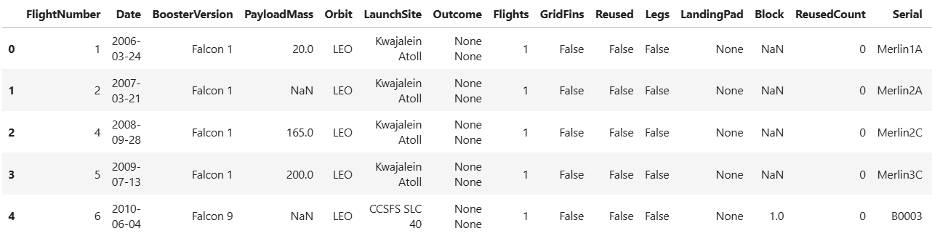
Data Collection
Data from SpaceX was obtained from two sources:
SpaceX REST API
SpaceX API link
WebScraping
Wikipedia link
Data collection steps
Step 1: Collect Data
from SpaceX API and Convert data to
.json file
Data set view
Step 2: Scrap and filter data to include Falcon 9 data, assign data to dataframe and dictionary, and export data to a csv file
Step 3: Plot and visualize the data

Slide 8
Data Collection – SpaceX API
We target the API endpoint, perform a get request, call the json function to view data, Convert json object into a dataframe and finally save the dataset
Data Collection – SpaceX API
Request response from SpaceX API using get request and covert data to .Jason file
Use custom functions to clean data
Clean data and assign data to dictionary and data frame
Filter data to include only Falcon 9 launches and export data to a csv file: dataset_part1

Slide 9
Data Collection - Scraping
We perform a HTTP get request, create a Beautiful Soup object from the HTML response, Extract the variables, create a dataframe from the HTML table and save the dataset as a csv file.
Data Collection – Scraping
Step 1: Perform HTTP get to
request Falcon 9 HTML page and create Beautiful Soup object from HTML
Step 2: Extract all column/variable names from the HTML table header
Step3: Create a data frame by parsing the launch HTML tables
Step 4: Export data into CSV file
(spacex_web_scraped.csv)

Slide 10

Data Wrangling
Steps
Below are orbits found in the dataset
Step 1: Load data from dataset_part1.csv file and calculate the number of launches on each site
Step 2: Calculate the number and the occurrence of each orbit
Step3: Calculate the number and occurrence of mission outcome of the orbits
Step 4: Create a landing outcome label from outcome column and export data into dataset_part2.csv file
Data wrangling

Slide 11
EDA with Data Visualization
Step 1: Visualize the relationship between flight number and launch site
Step 2: Visualize the relationship between payload and launch site
Step3: Visualize the relationship between success rate of each orbit type
Step 6: Visualize the launch success yearly trend
Step 5: Visualize the relationship between payload and orbit type
Step 4: Visualize the relationship between flight number and orbit type
Step 7: Create dummy variable to categorical columns
Step 8: Cast all numeric
columns to float64
EDA with visualization steps

Slide 12
EDA with SQL
Step 2: Display 5 records where launch sites begin with the string ‘CCA’
Step 3: Display average payload mass carried by booster launched by NASA (CRS)
Step 1: Display the names of the unique launch sites in the space mission
Step 4: Display average payload mass carried by booster version F9 v1.1
Step 8: List the names of the booster_ve which have carried the max payload mass
Step 7: List the total number of successful and failure mission outcomes
Step 6: List the names of the boosters which have success in drone ship and mass > 4000 & <6000
Step 5: List the date when the first successful landing outcome in ground pad was achieved
Step 9: List the records which display the month, failure landing, booster version ..etc.
Step 10: Rank the count of landing outcomes or success
EDA with SQL

Slide 13
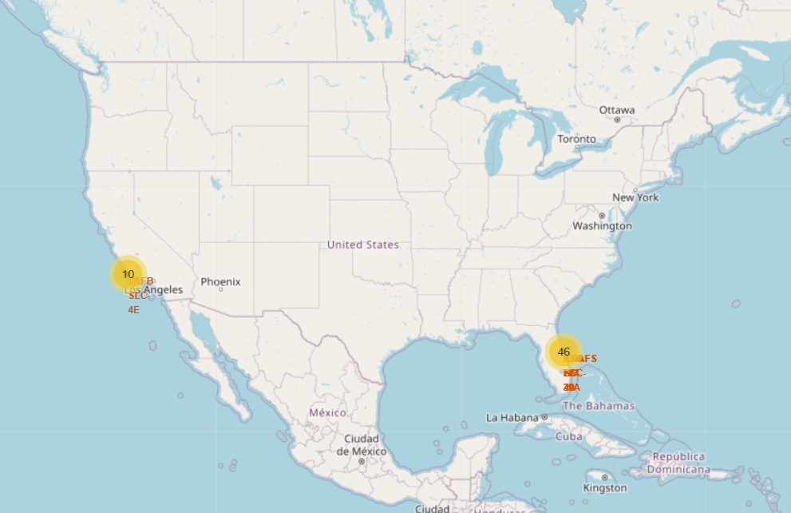
Build an Interactive Map with Folium
Step 1: Mark all launch sites on a map created using Folium by adding markers with circle , popup label and text label to each site using its longitude and latitude coordinates to show the geographical location approximately to the equator.
Step 1: Mark the success/failed launches for each site on the map using colored markers.
The launch sites are identified with yellow circles
Step 3: Calculate the distance between a launch site to its proximities
Visual Analytics with Folium

Slide 14
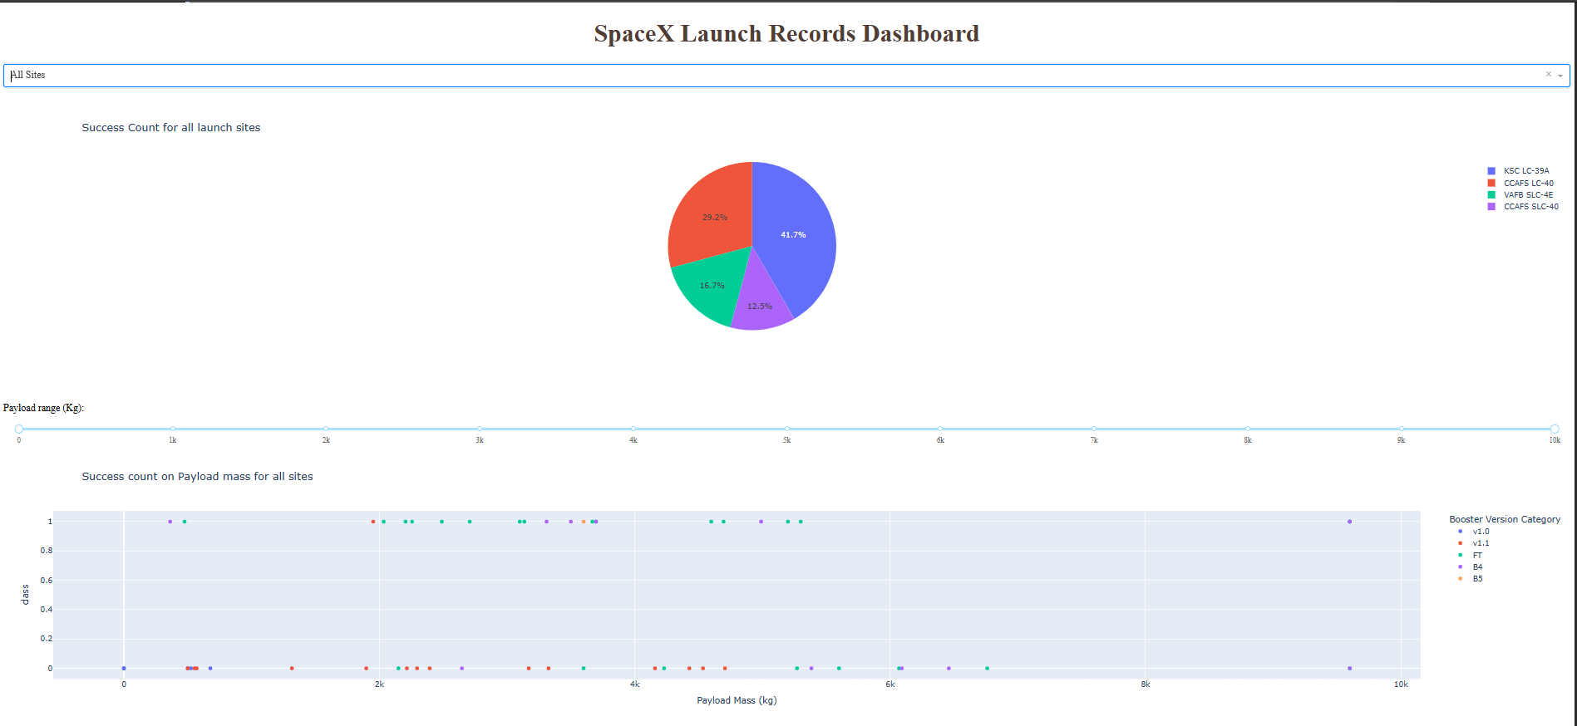
Build a Dashboard with Plotly Dash
Step 2: Add pie chart to show the total successful launches count for all sites and the success vs. failed counts
Step 1: Add dropdown list to enable launch site selection
Step 3: Add a range slider to select payload
Step 4: Add a scatter chart of payload mass vs. success rate of different booster versions
The dashboard shows the number of successful launches for each site
SpaceX Dash

Slide 15
Predictive Analysis (Classification)
Step 4: Use train_test_split to split the X & Y data into test and training data
Step 1: Load the dataframe
Step 2: Create Numpy array from the column class in the data
Step 3: Standardize the data in X and assign it variable Y
Step 8: Calculate the accuracy on the test data using the method score
Step 7: Create a support vector machine object then create a GridSearchCV
Step 6: Calculate the accuracy on the test data using score method
Step 5: Create a logistic object then create a GridSearchCV object
Step 9: Create a decision tree classifier object then create a GridSearchCV object
Step 10: Calculate the accuracy of tree- cv on the test data using the method score
Step 11: Create a K nearest neighbors object then GridSearchCV
Step 12: Calculate the accuracy of Knn-cv & find the method performs best
Machine Learning Prediction

Slide 16
Results
Space X dataset contains 4 different launch sites;
The first launches were done to Space X itself and NASA;
The average payload of F9 v1.1 booster is 2,534 kg;
The first successful landing outcome happened in 2015 fiver year after the first launch;
Many Falcon 9 booster versions were successful at landing in drone ships having payload above the average;
The majority of mission outcomes were successful;
Two booster versions failed at landing in drone ships in 2015: F9 v1.1 B1012 and F9 v1.1 B1015;
The number of landing outcomes became as better as years passed;
All the launch sites were located near coastlines;
For predictive analysis, the decision tree algorithm showed the highest performance.

Slide 17

Section 2

Slide 18
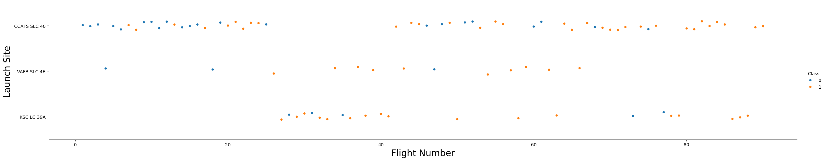
Flight Number vs. Launch Site
Flight Number vs. Launch Site
The majority of the flights were launched from the CCAFS SLC 40 sites.
The VAFB SLC 4E and KSC LC39A sites have higher success rates than other sites.
Newer flights have higher success rates than older flights.

Slide 19
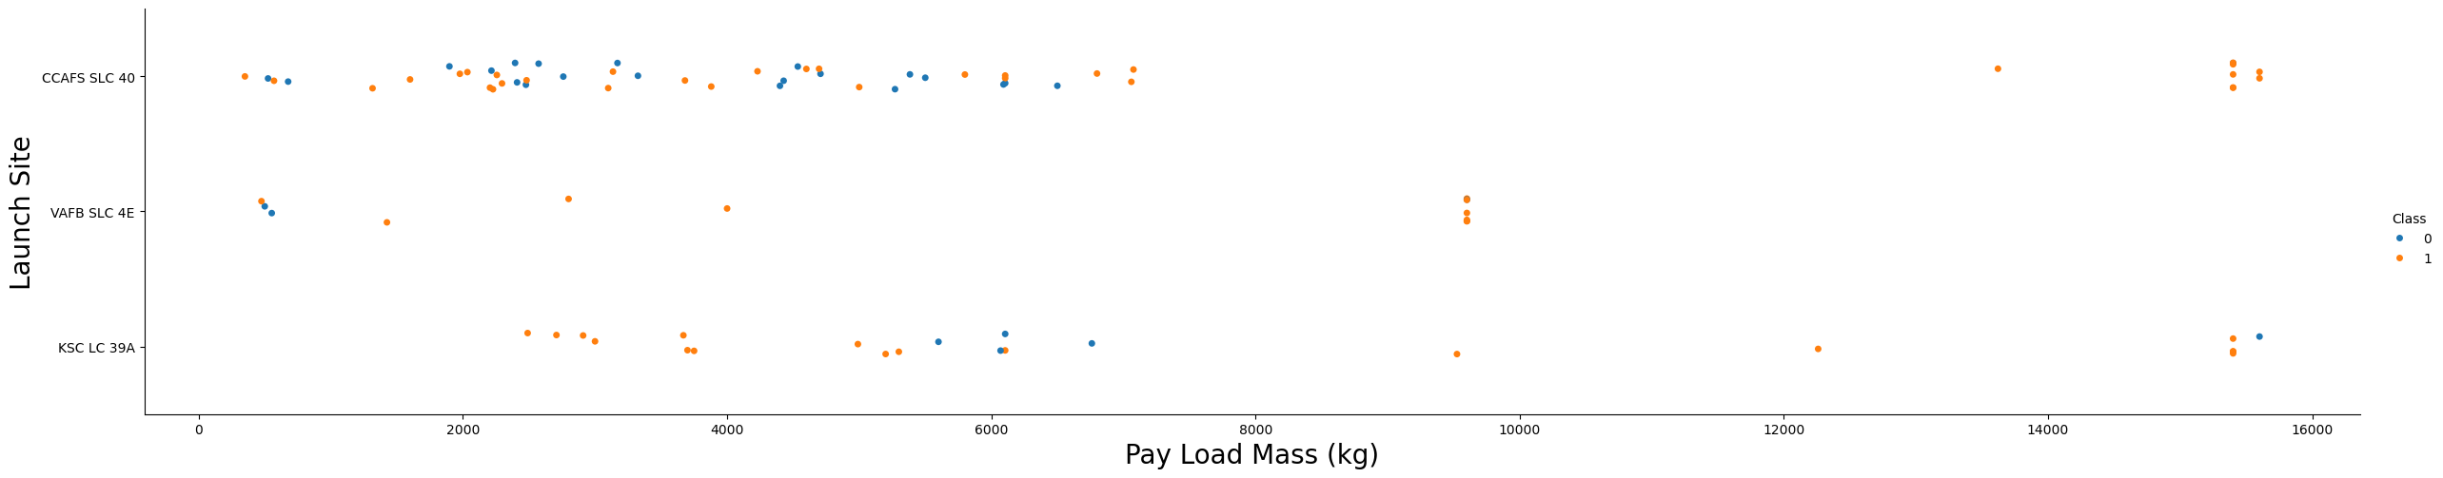
Payload vs. Launch Site
Payload vs. Launch Site
The majority of the flights with payload mass above 7000 Kg were successful.
KSC LC 39A success rate for payload mass under 5500 kg is 100%.
For all launch sites the success rate is proportional to the payload mass.

Slide 20
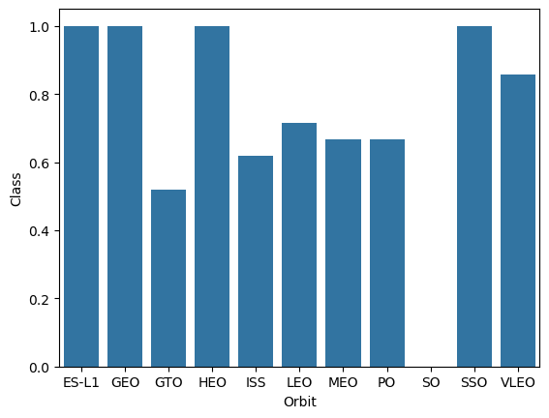
Success Rate vs. Orbit Type
Success Rate vs. Orbit Type
The SO orbit has 0% success rate.
The ELS-1, GEO, HEO and SSO orbits have 100% success rate.
Orbits GTO, ISS, LEO, MEO and PO success rate is higher than 50% and less than 75%.

Slide 21
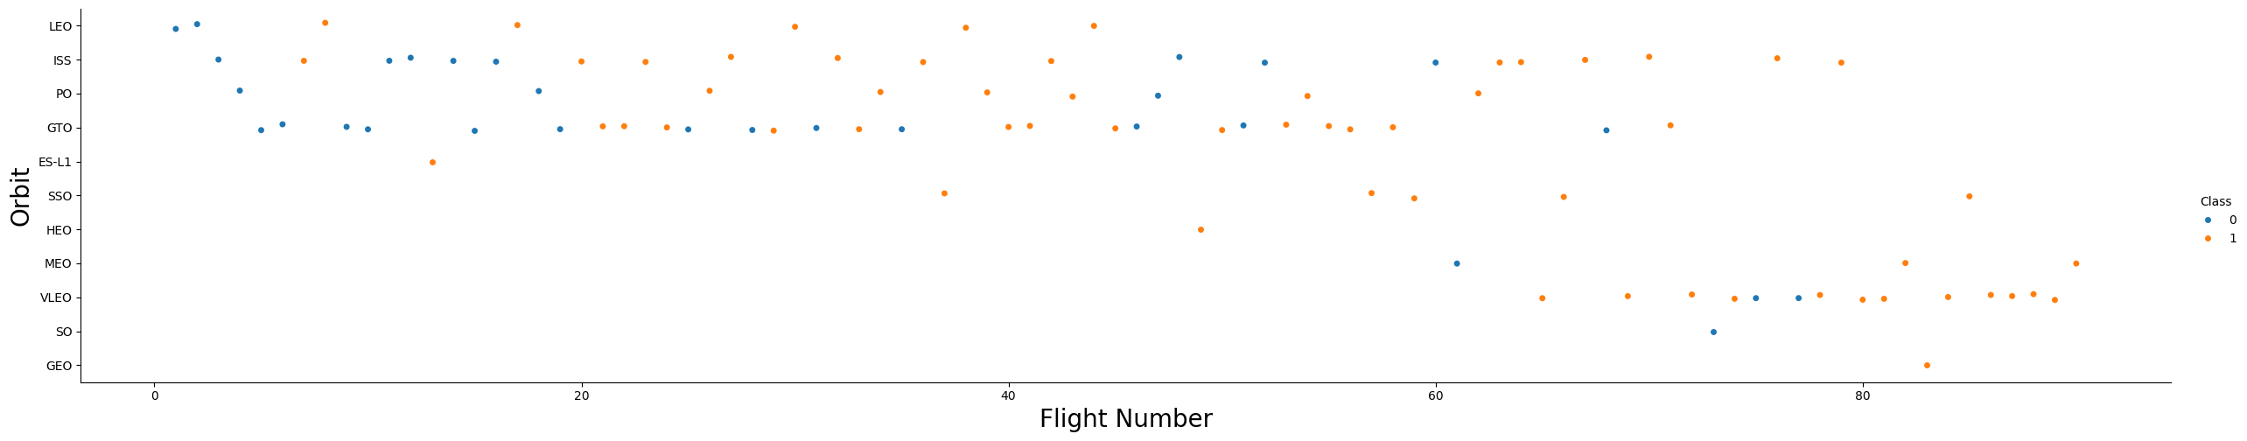
Flight Number vs. Orbit Type
Flight Number vs. Orbit Type
The majority of the flights were launches to the ISS and GTO orbits.
The data suggests that there is no relationship between the flight number and the orbit type.

Slide 22
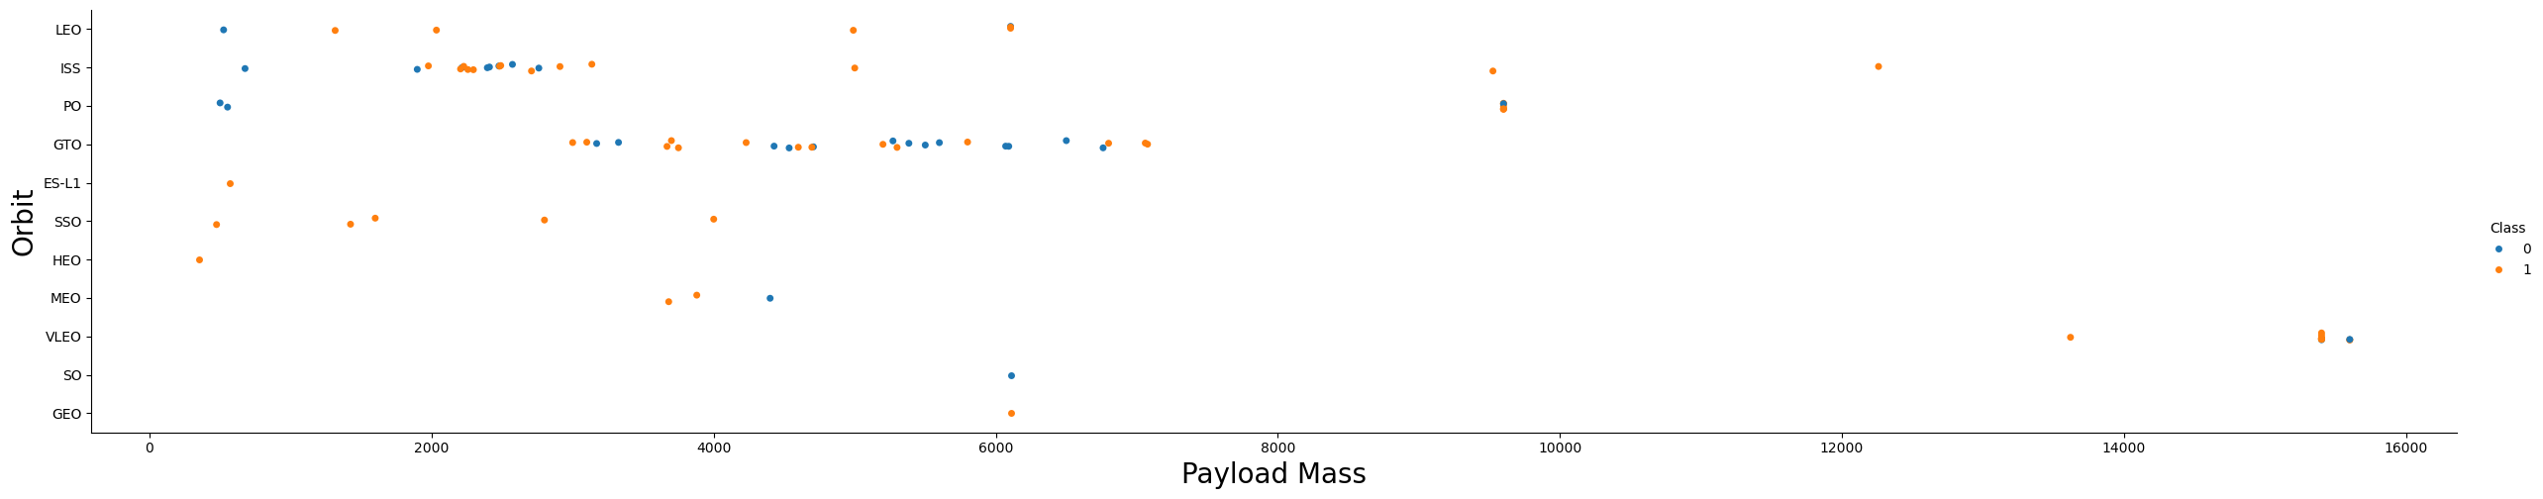
Payload vs. Orbit Type
Payload vs. Orbit Type
Payload masses above 10000Kg were placed in PO, ISS and LEO orbits.
Payload masses above 4000Kg and less than 8000Kg were placed in the GTO orbit.

Slide 23
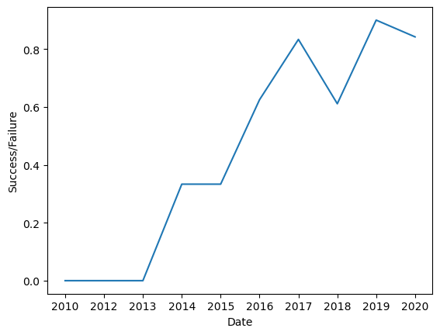
Launch Success Yearly Trend
Launch Success Yearly Trend
The launches success rate increased steadily since 2013.
The increase in the success rate between 2013 and 2017 was remarkable.
During 2018 there was a drop in the launches success rate.

Slide 24
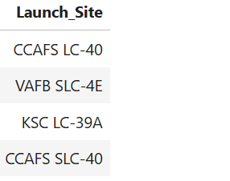
All Launch Site Names
SQL query
Launch sites

Slide 25
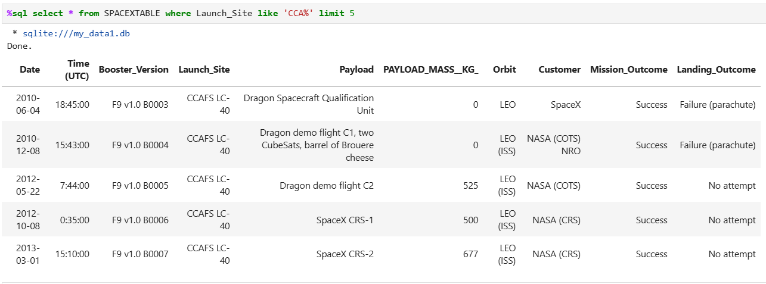
Launch Site Names Begin with 'CCA'
Launch Site Names Begin with 'CCA'

Slide 26
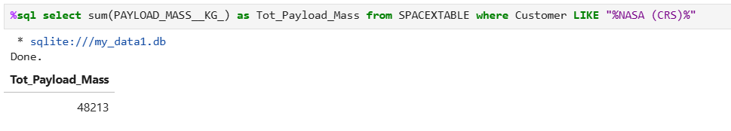
Total Payload Mass
Payload Mass
The total payload mass for customer NASA (CRC) est de 48213Kg

Slide 27
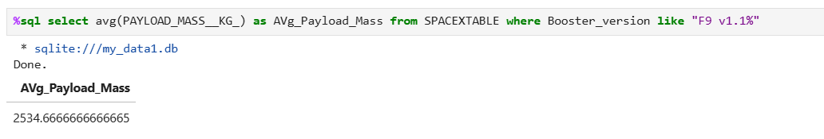
Average Payload Mass by F9 v1.1
Average payload mass
The average payload mass for Booster version F9 v1.1 is 2534 Kg

Slide 28
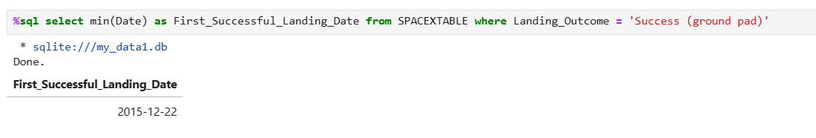
First Successful Ground Landing Date
First successful Date
The first time there was a successful ground landing was in December 2015

Slide 29
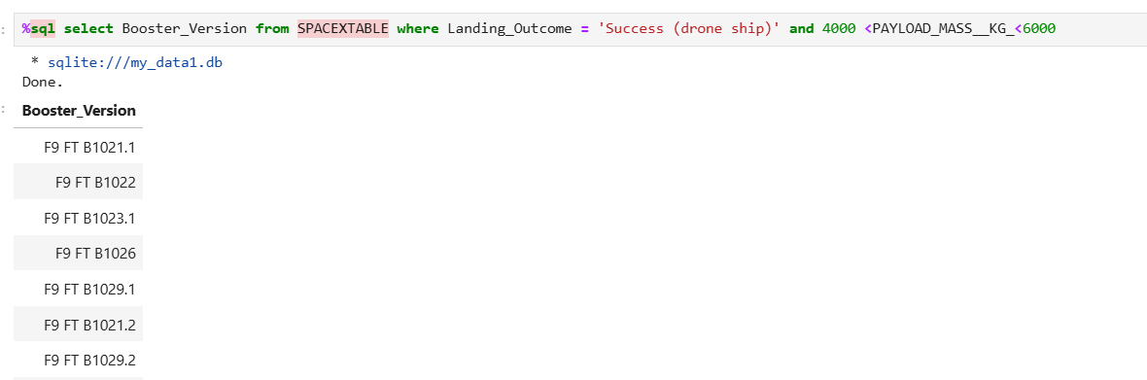
Successful Drone Ship Landing with Payload between 4000 and 6000
Below the query and results
The list in the picture above shows the booster versions that landed on Drone ship with payload between 4000 and 6000

Slide 30
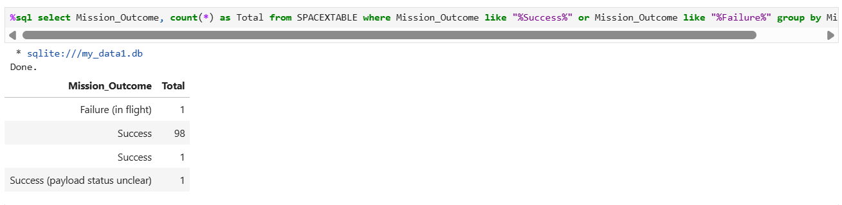
Total Number of Successful and Failure Mission Outcomes
The query used :
We can see that most of the outcomes were successful

Slide 31
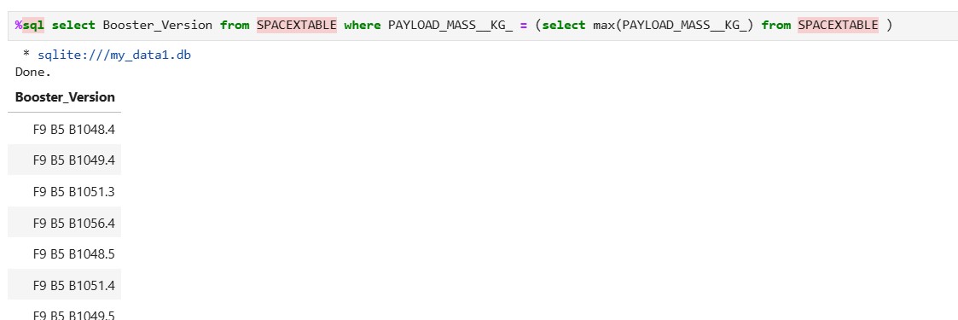
Boosters Carried Maximum Payload
The query used :
The above picture shows the boosters with maximum payload

Slide 32
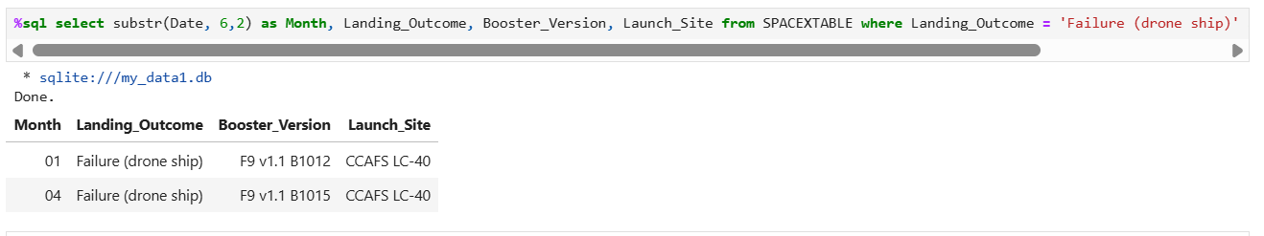
2015 Launch Records
The query used :
The results list the failed landing outcomes in drone ship, their booster versions, and launch site names in year 2015

Slide 33
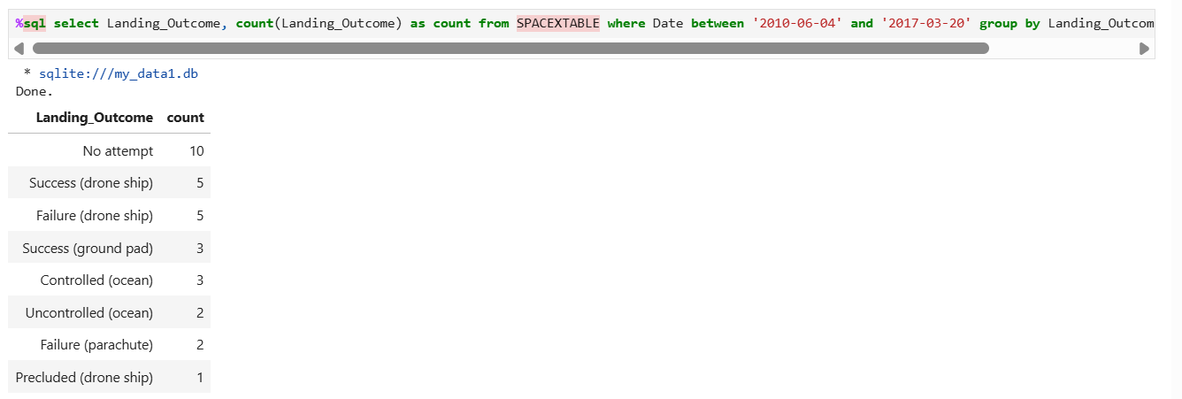
Rank Landing Outcomes Between 2010-06-04 and 2017-03-20
The results rank the count of landing outcomes (such as Failure (drone ship) or Success (ground pad) between the date 2010-06-04 and 2017-03-20, in descending order

Slide 34

Section 3

Slide 35
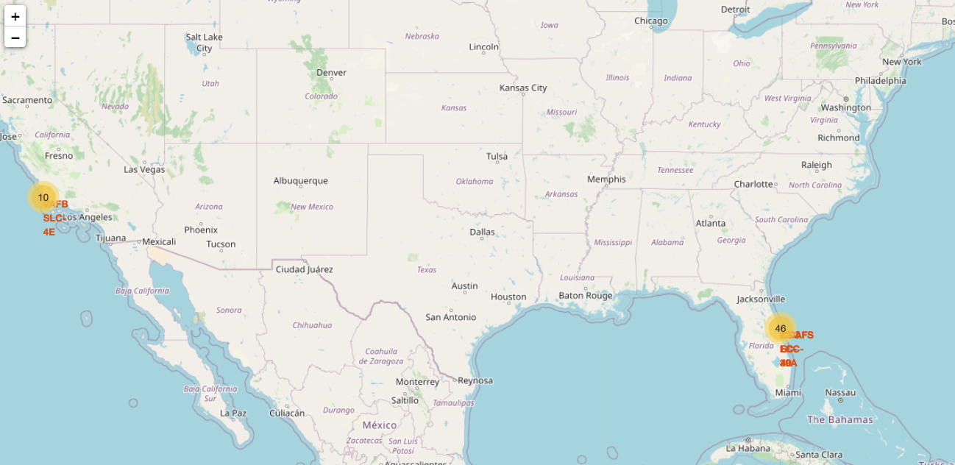
USA Launch Sites in California and Florida
Map generated with Folium
Launch sites are indicated in yellow circles on the Map

Slide 36

Color Labels Showing the Launch Sites on a Map
Launch sites are circles in red and in each site there are red markers for failed outcomes and green markers for successful outcomes

Slide 37
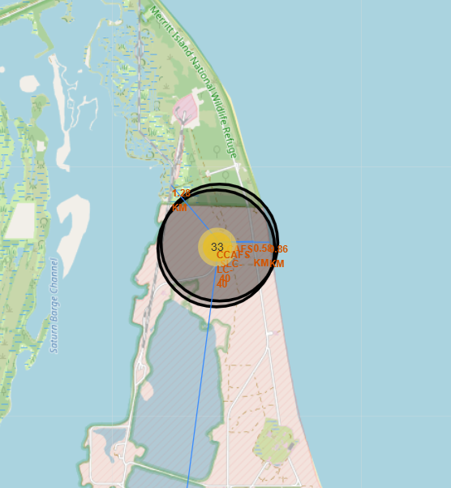
Safe Distance to Launch Site
The obtained results indicate that all launch sites are at safe distance from railway lines, airports and cities.

Slide 38

Section 4

Slide 39
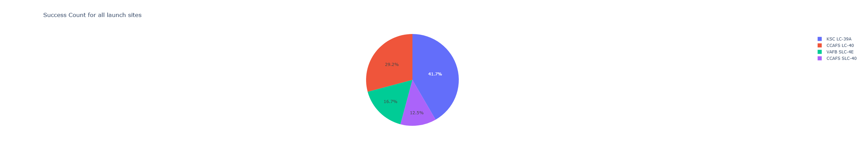
Total Launch Success for All Sites
The highest success launch rates were recorded at these sites :
1. K S C LC-39A (41.7%)
2. C CAFS LC-40 (29.2%)

Slide 40
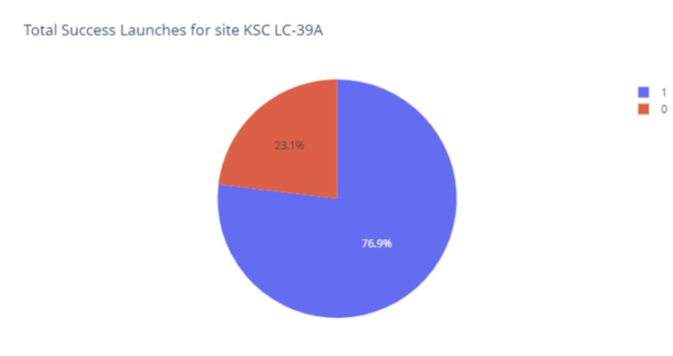
KSC LC-39 Launch Site Success Rate
Site KSC LC-39 success rate is 76.9%

Slide 41
Payload vs. Launch Outcome for All Sites
Payload vs. Launch
Highest success rate for payloads is between 2000 and 5500 Kgs

Slide 42

Section 5

Slide 43
Classification Accuracy
Cross validation
Test data
The Tree Model provided the best accuracy results for the cross-validation stage and the test set

Slide 44

Confusion Matrix
Decision Tree
The confusion matrix analysis suggests that the best performing model is the decision tree classifier.
The confusion matrix predicts 12 true positives, 1 false positive, 5 true negatives, and 0 false negative.

Slide 45
Conclusions
SpaceX data was collected using SpaceX API and web Scraping
Date wrangling and EDA were performed
The success rate for the rocket launches increased after 2013.
Orbits GEO, HEO, ES-L1 and SSO have 100% launch success rate.
Launch site KSC LC-39A has the highest success rate.
Predictive analysis was performed using Logistic Regression, Support Vector Machine, Decision Tree and K-Nearest Neighbors.
The Decision Tree model is the best ML algorithm for analyzing the SpaceX data set and provided the best accuracy results.

Slide 46
Appendix
Applied Data Science Capstone Project – Coursera Link
DS-Professional-Certificate-Project - Git Hub Link

Slide 47


